Slide 1
Diagnosis of acute diseases in villages and smaller towns using AI
PIP2001 Capstone Project
Review-4
Batch Number:CAI-09
Under the Supervision of,
Ms.DEEPTHI
Assistant Professor
School of Computer Science and Engineering
Presidency University
Roll Number | Student Name
20211CAI0139 | SOURAV N
20211CAI0113 | HARISHANKAR B L
20211CAI0114 | MH USAMA AHMED
20211CAI0120 | PRIYA LU
20211CAI0179 | SHASHANK R KOUSHIK
Name of the Program : Computer science and engineering (Artificial Intelligence and Machine Learning)
Name of the HoD : DR.Zafar Ali Khan
Name of the Program Project Coordinator: DR.Afroz Pasha
Name of the School Project Coordinators: Dr. Sampath A K / Dr. Abdul Khadar A / Mr. Md Ziaur Rahman

Slide 2
Introduction
In rural areas and smaller towns, access to healthcare can be limited, leading to delays in the diagnosis and treatment of acute diseases. The integration of Artificial Intelligence (AI) into healthcare systems offers a promising solution to bridge this gap. AI technologies can enhance diagnostic accuracy, streamline patient data management, and provide real-time health insights. By leveraging AI-driven tools, healthcare providers in these communities can improve patient outcomes, ensure timely interventions, and ultimately strengthen local health systems. Moreover, the use of AI can empower local healthcare workers with decision-support systems, enabling them to provide high-quality care despite limited resources. This presentation explores the potential of AI in diagnosing acute diseases in underserved regions, highlighting innovative applications and real-world examples

Slide 3
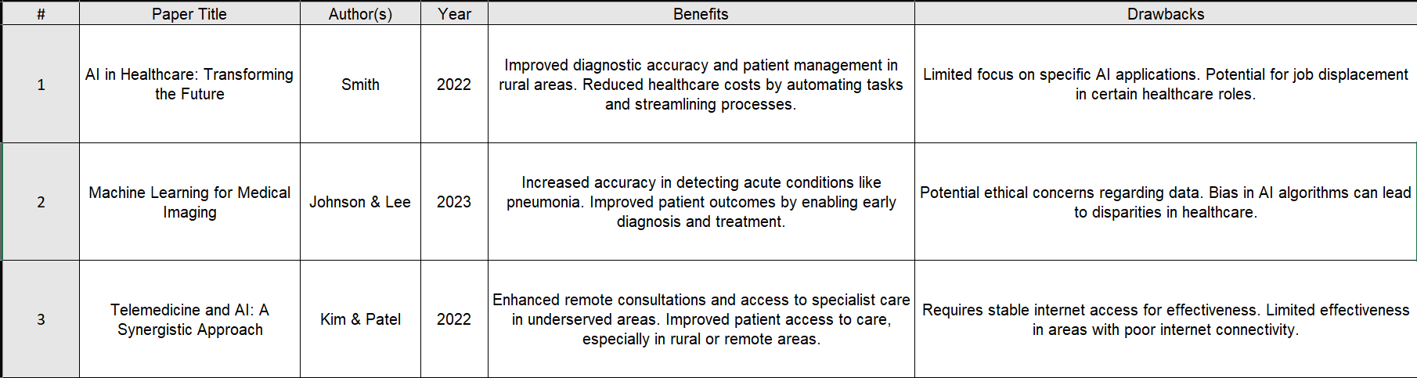
Literature Review

Slide 4
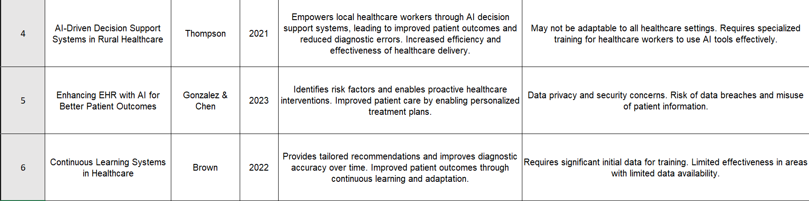
Literature Review

Slide 5
Existing method Drawback
Traditional diagnostic methods in rural healthcare often rely on clinical examinations and basic laboratory tests, which can be time-consuming and limited by the availability of skilled healthcare professionals.
Drawbacks:
1. Limited Access to Specialists: Rural areas frequently lack specialists, leading to referrals that can delay diagnosis and treatment.
2. Inconsistent Training: Healthcare providers may have varying levels of training, affecting the accuracy and consistency of diagnoses.
3. Resource Constraints: Basic diagnostic tools may be outdated or unavailable, hindering effective assessment of acute diseases.
4. Time-Consuming Processes: Manual record-keeping and patient assessments can lead to inefficiencies, increasing wait times and affecting patient care.
5. Subjectivity in Diagnosis: Relying on clinicians' judgment alone can introduce bias and result in misdiagnoses, particularly in acute cases where quick decisions are critical.
These limitations highlight the need for AI-driven solutions that can enhance diagnostic capabilities and streamline healthcare delivery in these communities.

Slide 6
Proposed Method
To address the limitations of traditional diagnostic approaches in rural healthcare, the integration of AI-driven diagnostic tools is proposed. This method involves the development and deployment of a multi-faceted AI system that includes:
Proposed Methodology:
1. AI-Powered Symptom Checker
Develop mobile application using fine-tuned Medical-Llama3-8B.
Integrate with Google Translate API for multilingual support.
2. Diagnostic Imaging Analysis
Utilize Google Cloud Vision API for image analysis.
Train models to detect conditions like pneumonia, fractures, and skin diseases.
3. Telemedicine Integration
Combine AI tools with telemedicine platforms.
Enable remote consultations and real-time specialist input.
4. Electronic Health Records (EHR) Enhancement
Implement AI algorithms to analyze patient histories.
Identify risk factors and potential acute conditions.
5. Continuous Learning System
Develop AI models learning from local health data.
Provide tailored recommendations and improve accuracy.
This proposed method aims to empower local healthcare providers, reduce diagnostic errors, and improve patient outcomes by ensuring timely and accurate interventions for acute diseases in villages and smaller towns.

Slide 7
Objectives
Here are three objectives that the AI-Driven Diagnostic Assistant for Acute Diseases in Rural India addresses and solves:
Objective 1: Improve Diagnostic Accuracy
Develop an AI-powered diagnostic tool that accurately identifies acute diseases in rural India.
Reduce diagnostic errors by 30% through AI-driven symptom analysis and imaging diagnostics.
Enhance patient outcomes through timely and accurate interventions.
Objective 2: Enhance Accessibility to Quality Healthcare
Increase access to quality healthcare services for rural populations.
Reduce healthcare disparities by providing AI-driven diagnostic support to local healthcare providers.
Expand telemedicine services to reach remote and underserved areas.
Integrate Google Translate API to support native Indian languages.

Slide 8
Objectives(contd..)
Objective 3: Empower Local Healthcare Providers
Develop AI-driven decision-support systems for local healthcare providers.
Enhance provider capacity through AI-driven training and education.
Improve provider confidence in diagnosing and treating acute diseases.
Key Performance Indicators (KPIs):
Diagnostic accuracy rate
Reduction in diagnostic errors
Increase in telemedicine consultations
Provider satisfaction and confidence
Patient outcomes and satisfaction

Slide 9
Methodology/Modules
Here are the methodology/modules to be followed for the AI-Driven Diagnostic Assistant for Acute Diseases in Rural India:
Module 1: Data Collection and Preprocessing
Literature review and dataset identification
Data collection from various sources (Kaggle,UCI Machine Learning Repository,Data.gov.in)
Data preprocessing (cleaning, tokenization, normalization)
Data annotation and labeling
Module 2: AI Model Development
Selection of suitable AI algorithms
Model training and fine-tuning
Hyperparameter optimization
Model evaluation and validation
Module 3: Symptom Checker Development
Integration with AI model
Development of user-friendly interface
Symptom analysis and recommendation engine
Testing and validation
Module 4: Diagnostic Imaging Analysis
Integration with Google Cloud Vision API
Development of image analysis algorithms
Training and testing of image analysis models
Validation and evaluation

Slide 10
Methodology/Modules(contd..)
Module 5: Telemedicine Integration
Selection of telemedicine platform
Integration with AI-driven diagnostic assistant
Development of user-friendly interface
Testing and validation
Module 6: Native Language Translation
Language Identification: Use language detection libraries to identify patient's preferred language.
Text Translation: Integrate Google Cloud Translation API for text inputs and outputs.
Speech-to-Text: Utilize Google Cloud Speech-to-Text API for speech recognition in Indian languages.
Text-to-Speech: Use Google Cloud Text-to-Speech API for audio outputs in Indian languages.
Module 7: Electronic Health Records (EHR) Enhancement
Integration with EHR system
Development of AI-driven analytics
Identification of risk factors and potential acute conditions
Validation and evaluation
Module 8: Continuous Learning System
Development of feedback mechanism
Integration with AI model
Continuous learning and updating of AI model

Slide 11
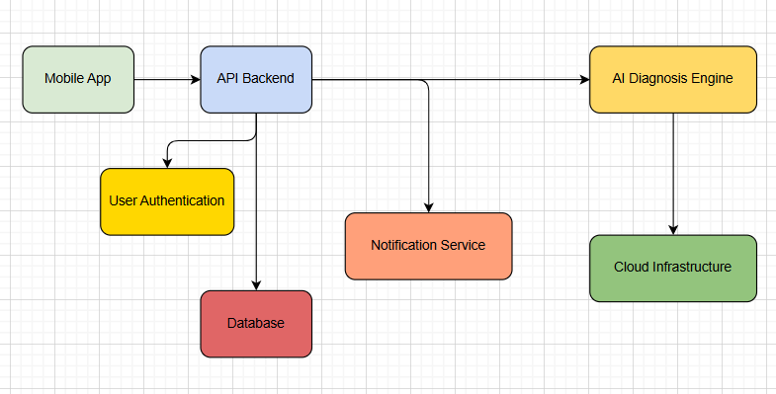
Architecture

Slide 12
Hardware components
Cloud Instances: AWS EC2, Google Cloud Compute, or Azure VMs with at least 4–8 vCPUs and 16GB+ RAM.
GPU for AI Training: NVIDIA Tesla V100/A100 (for training large AI models).
Edge Devices: Smartphones (Android/iOS) for user interaction
Development Machines: Intel i7/AMD Ryzen 7, 16GB+ RAM, SSD for fast performance during development.
High-Speed Internet: Minimum 10–50 Mbps bandwidth for smooth real-time video consultations and data transfers.
Local Servers (Edge Computing): For processing in regions with poor internet connectivity.

Slide 13
Software components
Programming Languages:
Python 3.x (primary language)
JavaScript (for web interface)
Libraries and Frameworks:
Hugging Face Transformers (for fine-tuning pre-trained models)
TensorFlow or PyTorch (for deep learning)
OpenCV (for image processing)
NLTK or spaCy (for natural language processing)
APIs and Services:
GPT 4v- (for image analysis)
OpenAI Whisper (for language translation)

Slide 14

Timeline of the Project (Gantt Chart)
PROCESS | QUARTER 1 |  |  | QUARTER 2 |  |  | QUARTER 3
 | WEEK 1 | WEEK 2 | WEEK 3 | WEEK 4 | WEEK 5 | WEEK 6 | WEEK 7 | WEEK 8 | WEEK 9
PLANNING
WIRE FRAMING
DESIGN PROCESS
FRONT END
BACK END
DEPLOYEMENT

Slide 15
Expected Outcomes
Improved Diagnostic Accuracy: Increased precision in diagnosing acute diseases through AI-enhanced tools, leading to reduced misdiagnoses and more effective treatment plans.
Faster Response Times: Reduced time between symptom onset and diagnosis, enabling timely interventions and improving patient outcomes.
Increased Access to Care: Enhanced availability of healthcare services in rural areas through telemedicine and mobile applications, ensuring that patients can receive timely assessments without traveling long distances.
Empowered Healthcare Providers: Local healthcare workers equipped with AI tools will have improved confidence and capability in managing acute conditions, leading to higher quality care.
Enhanced Patient Engagement: Patients become more involved in their healthcare through accessible symptom checkers and educational resources, leading to better understanding and management of their health.
Data-Driven Decision Making: Utilization of AI analytics will enable more informed clinical decisions, tailoring interventions to individual patient needs based on comprehensive data analysis.
Reduction in Healthcare Disparities: Addressing gaps in healthcare access and quality in rural communities, contributing to more equitable health outcomes across different populations.
Positive Health Metrics: Overall improvement in health indicators, such as reduced hospital admission rates for acute conditions, better management of chronic diseases, and enhanced quality of life for patients in rural areas

Slide 16
Conclusion
The integration of Artificial Intelligence in the diagnosis of acute diseases in villages and smaller towns represents a transformative opportunity to enhance healthcare delivery in underserved regions. By addressing the existing challenges of limited access, resource constraints, and variable training among healthcare providers, AI-driven solutions can significantly improve diagnostic accuracy and patient outcomes. Through mobile applications, telemedicine, and advanced analytics, local healthcare workers will be empowered to make informed decisions, fostering a more efficient and responsive healthcare system.ultimately, this approach not only addresses immediate health needs but also promotes long-term sustainability and equity in healthcare access. As we move forward, continued collaboration between technology developers, healthcare professionals, and communities will be essential to ensure that these innovations effectively meet the unique challenges of rural healthcare, paving the way for a healthier future for all

Slide 17
Github Link
The GitHub link provided should have public access permission.
GitHub Link(https://github.com/sounar97/VillageCare-AI)

Slide 18
References (IEEE Paper format)
[1]International Journal of Research Publication and Reviews Journal homepage:
www.ijrpr.com ISSN 2582-7421
[2]The Application of Medical Artificial Intelligence Technology in Rural Areas of Developing Countries
www.researchgate.net
[3]Medical Diagnostic Systems Using Artificial Intelligence (AI) Algorithms: Principles and Perspectives (Link)
[4]Artificial intelligence in medicine: current trends and future possibilities (Link)
[5]The potential for artiﬁcial intelligence in healthcare(Authors:Thomas Davenport and Ravi Kalakota)
[6]Revolutionizing healthcare: the role of artificial intelligence in clinical practice (BMC Medical Education )

Slide 19
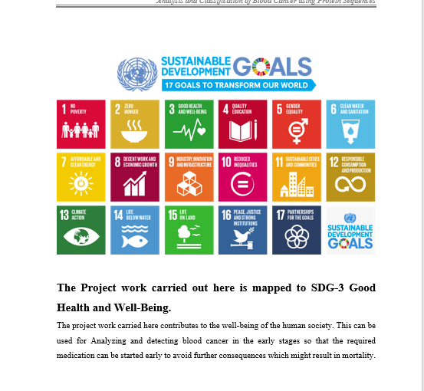
Project work mapping with SDG
Diagnosis of acute diseases in villages and smaller towns using AI, is primarily related to SDG 3: Good Health and Well-Being and SDG 9: Build resilient infrastructure, promote inclusive and sustainable industrialization. SDG 17: Partnerships for the goals.
This goal aims to ensure healthy lives and promote well-being for all at all ages. Specifically, it addresses the need for universal health coverage, access to quality essential health care services, and the reduction of mortality from communicable and non-communicable diseases.

Slide 20
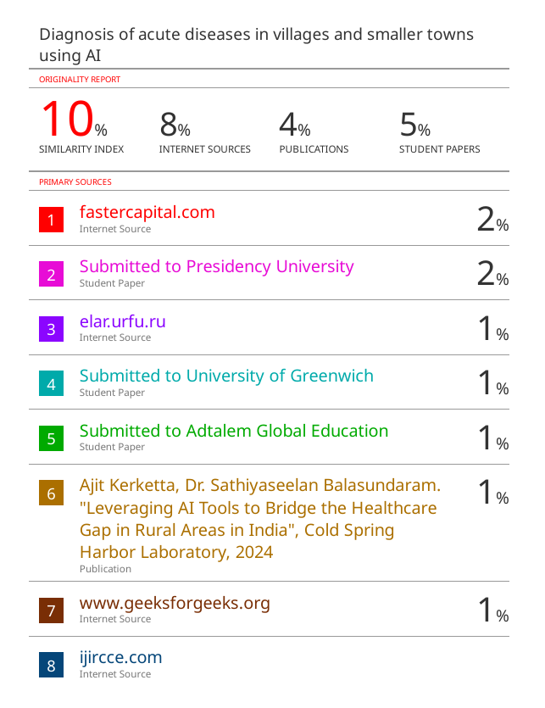
Paper Publication

Slide 21
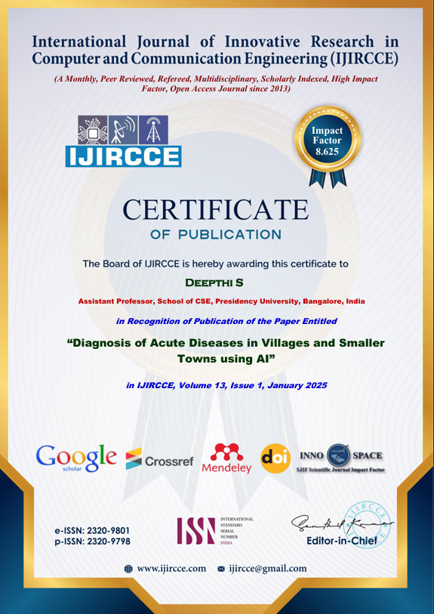
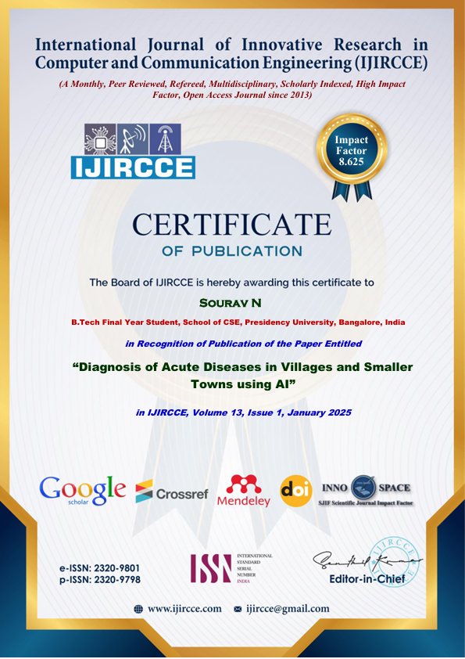
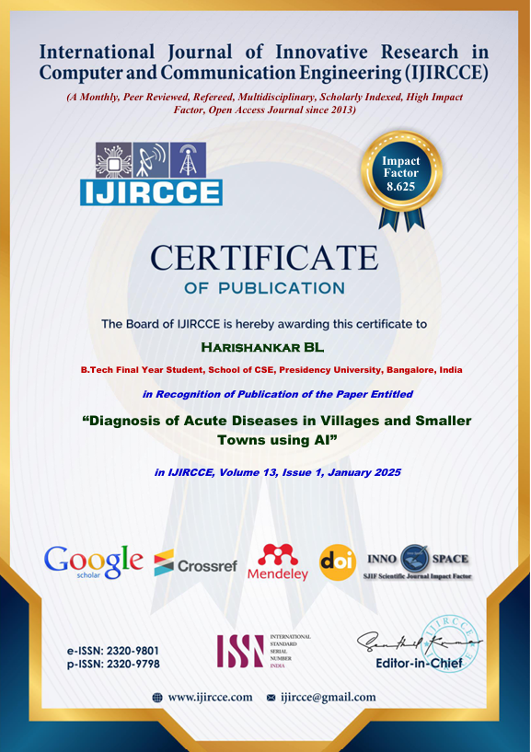
Achievements

Slide 22
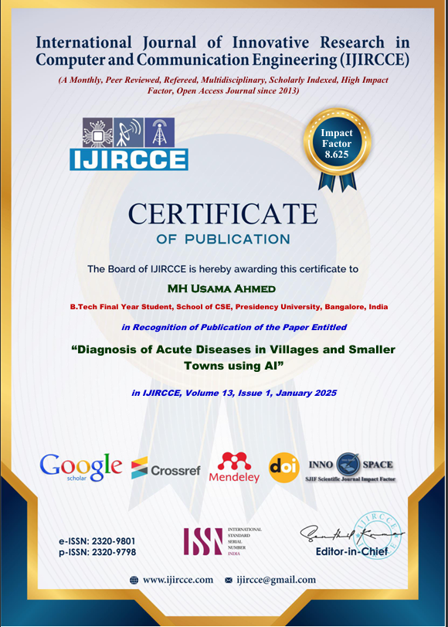
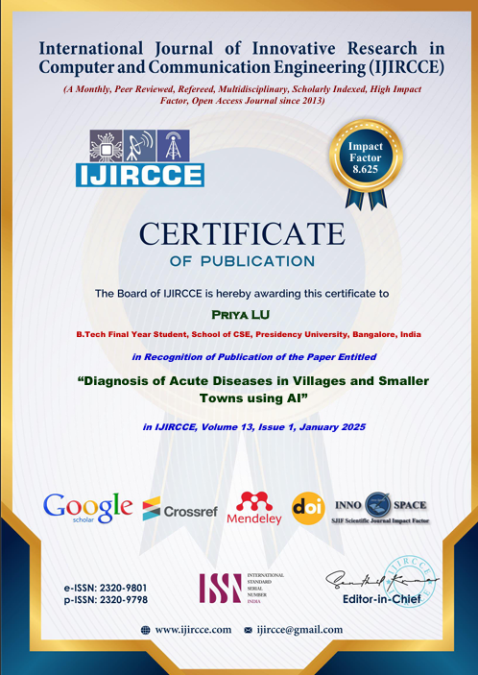
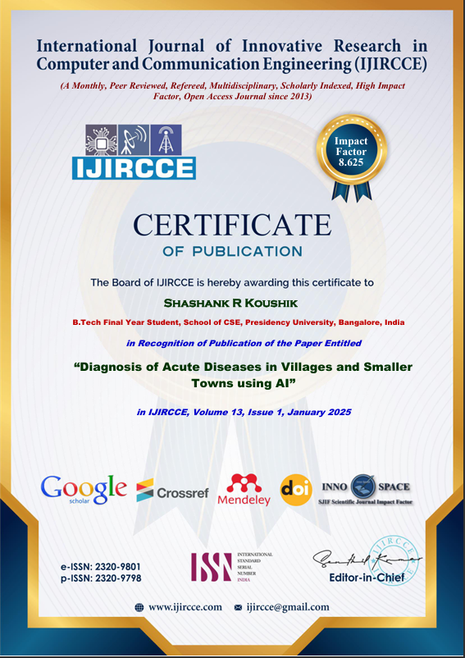
Achievements

Slide 23


